Slide 1


Bank Loan

Slide 2



Key Performance Indicators
Total Fund Amount
Total Applications
Total Amount Received
Average Interest Rate
Average Debt to Income

Slide 3
Dashboard 1
Key Performance Indicators(SUMMARY)
Total Loan Application: We need to calculate the total number of applications received during a specified period. Additionally, it its essential to monitor Month-to- Date(MTD) Loan applications and track changes Month-over-Month(MOM).
Total Funded Amount: Understanding the total amount of funds disbursed as loans is crucial. We also want to keep an eye on the MTD Total Funded Amount and analyse the Month-over-Month (MoM) changes in this metric.
Total Amount Received: Tracking the total amount received from borrowers is essential for assessing the bank's cash flow and loan repayment. We should analyse the Month-to-Date (MTD) Total Amount Received and observe the Month-over-Month (MoM) changes.
Average Interest Rate: Calculating the average interest rate across all loans, MTD, and monitoring the Month-over-Month (MoM) variations in interest rates will provide insights into our lending portfolio's overall cost.
Average Debt-to-Income: Evaluating the average DTI for our borrowers helps us gauge their financial health. We need to compute the average DTI for all loans, MTD, and track Month-over-Month (MoM) fluctuations.

Slide 4
Good Loan vs Bad Loan KPIs (Overview)
Good Loan
Bad Loan
Bad Loan Application %
Bad Loan Application
Bad Loan Funded Amount
Bad Loan Total Received
Good Loan Application %
Good Loan Application
Good Loan Funded Amount
Good Loan Total Received Amount

Slide 5
Dashboard 2
(Overview)
Charts
Monthly trends by issue date(Line chart)
Regional Analysis by State(Filled Map)
Loan Term Analysis (Donut Chart)
Employment Length Analysis(Bar chart)
Loan Purpose Breakdown(Bar Chart)
Home Ownership Analysis(Tree Map)

Slide 6
Dashboard 3
(Details)
GRID
Need for a comprehensive 'Details Dashboard' that provides a consolidated view of all the essential information within our loan data. This Details Dashboard aims to offer a holistic snapshot of key loan-related metrics and data points, enabling users to access critical information efficiently.
Objective:
The primary objective of the Details Dashboard is to provide a comprehensive and user-friendly interface for accessing vital loan data. It will serve as a one-stop solution for users seeking detailed insights into our loan portfolio, borrower profiles, and loan performance.

Slide 7
Microsoft SQL Server Management
POWER BI
Connecting to SQL Server
Data Cleaning
Data Modelling
Data Processing
Power Query
Date Tables
Time Intelligence Func
DAX
Date Function
Text Function
Filter Function
Calculate
SUM/ SUMX
Creating KPI’s
New Card Visual
Creating Charts
Formatting visuals
Creating Functions
Navigations
Creating Database
Creating Table
Select
Datename
Datepart
Cast
Decimal
Month
Hour
Quarter
Day
Group by
Order by
Decimal
Limit
Count
Distinct
CTE
Partition

Slide 8
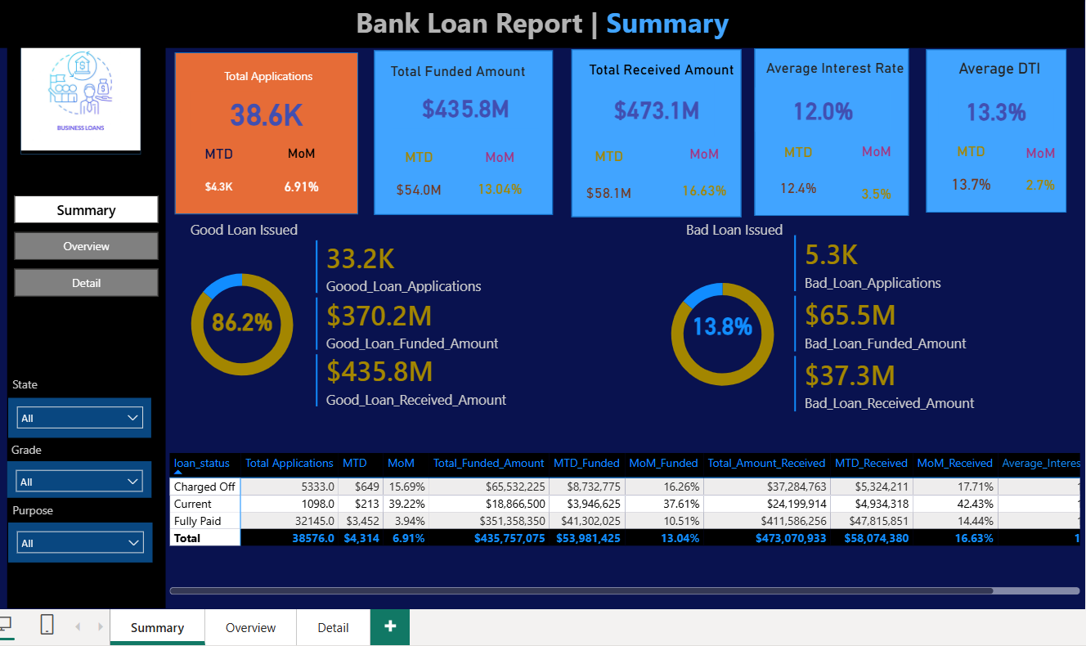

Slide 9
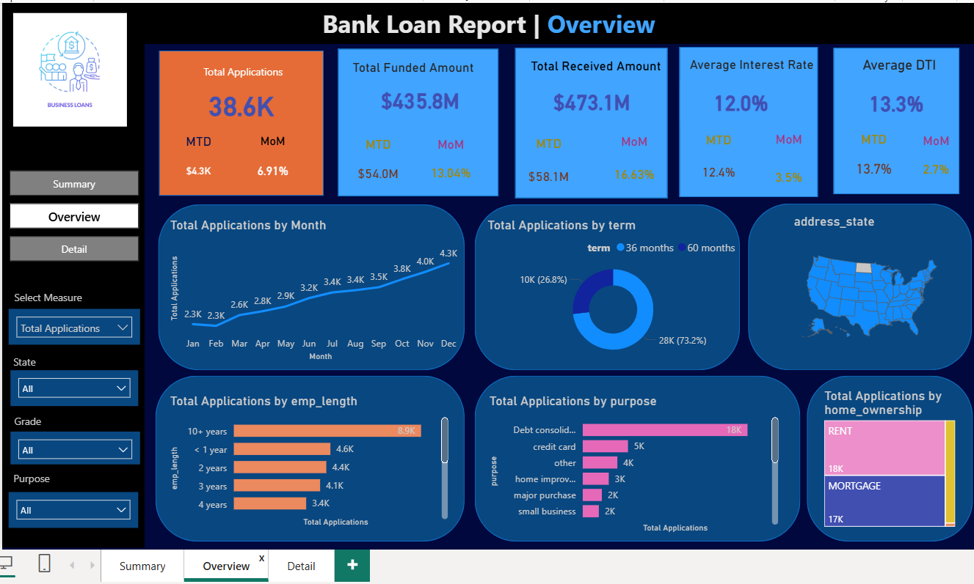

Slide 10
